Slide 1
Swin Transformer-based Deep Learning Framework to Integrate Radiology and Pathology for
Outcome predictions in head and neck cancer
Bolin Song
Department of Biomedical Engineering
Notes:
Titre + figure pipeline : mettre l’accent sur la contribution avec cartilage. Exploiter les caracs des différents tissus dans la méthode de registration. Faire reference aux figures suivantes pour chaque sous bloc

Slide 2
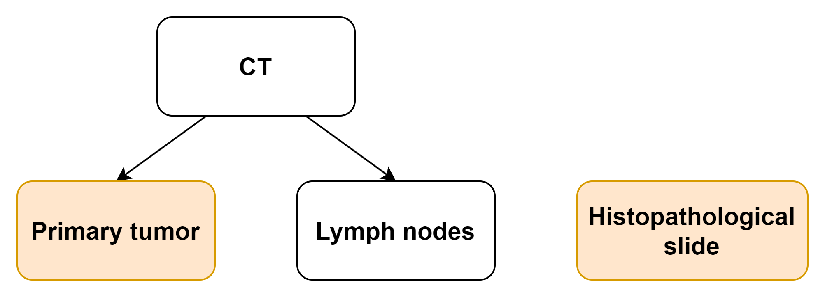
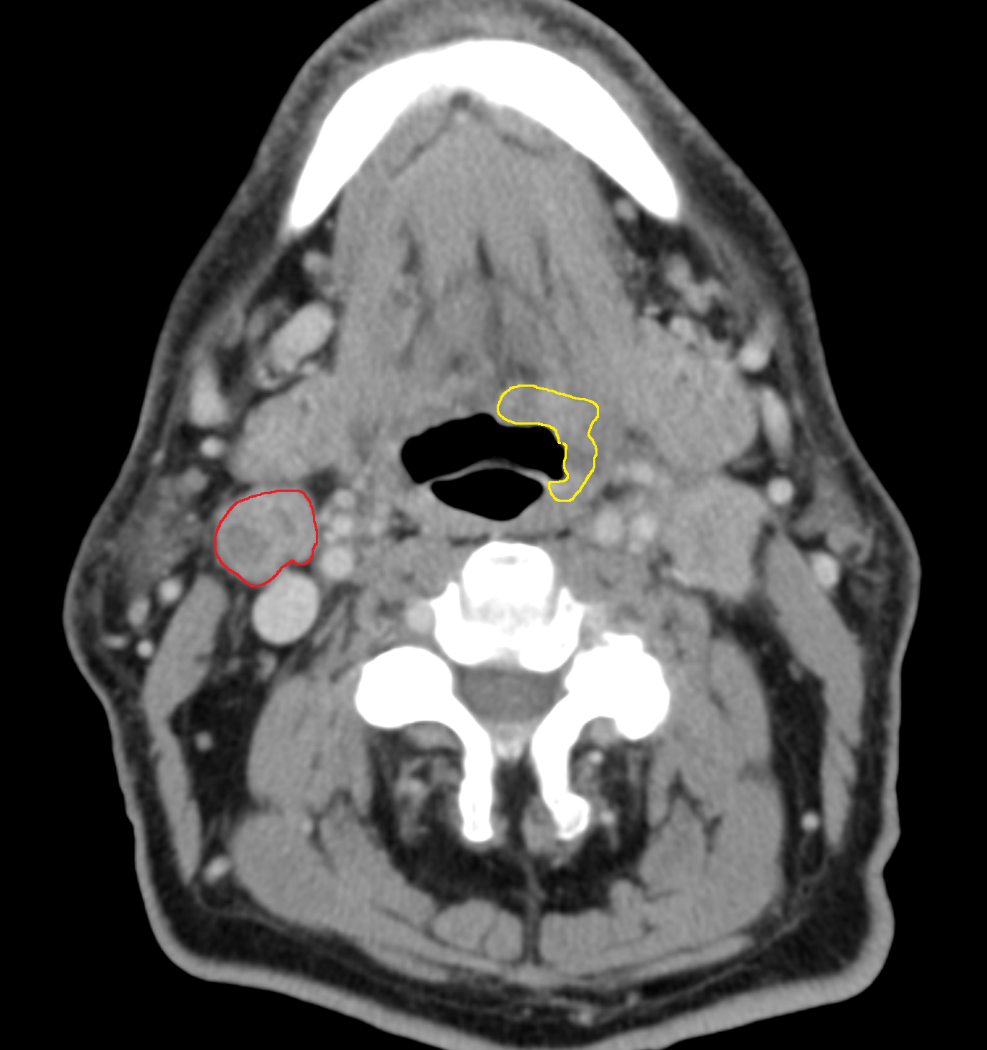
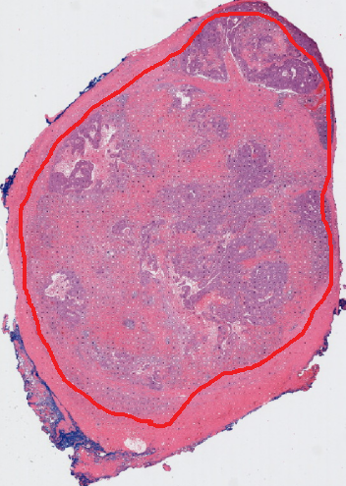
Background
Head and neck
cancer patients
Clinical endpoint: Survival Outcomes
Data:
  CT: delineated tumor & lymph nodes
  Histopathological slides: delineated tumor
Question:
  What features to extract from both modalities?
  How to account for the scale differences?
1mm/pixel vs. 0.5 µm/pixel
Macroscopic Microscopic

Slide 3
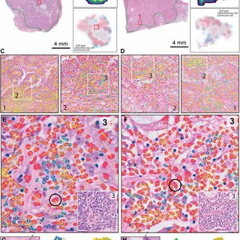
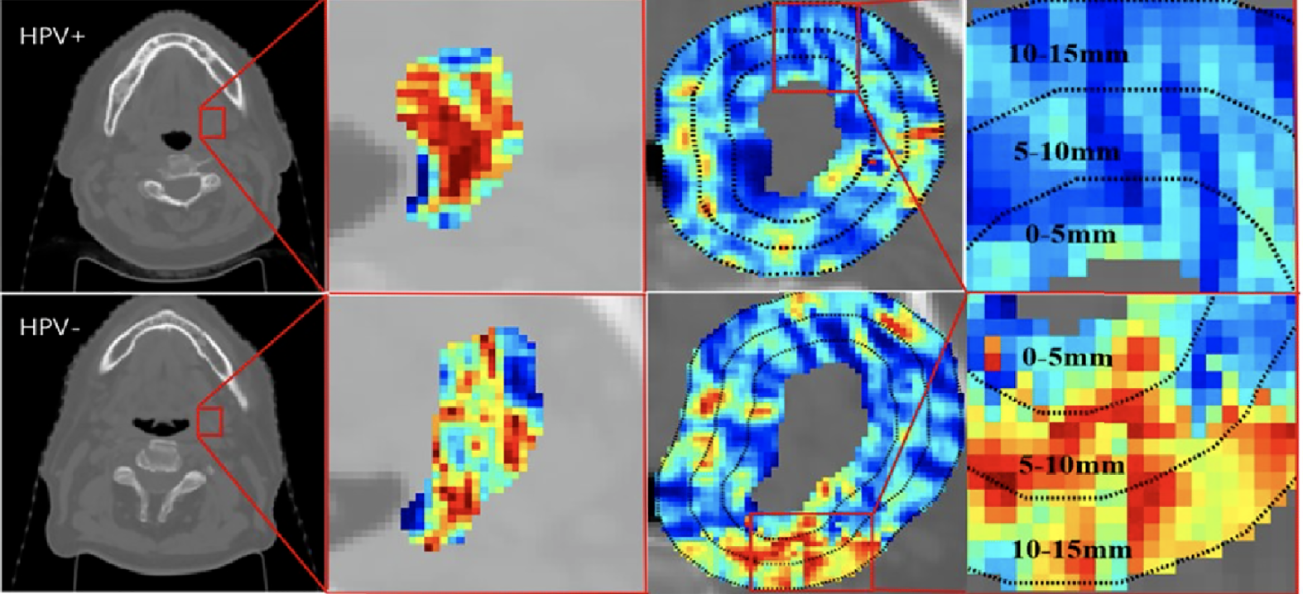
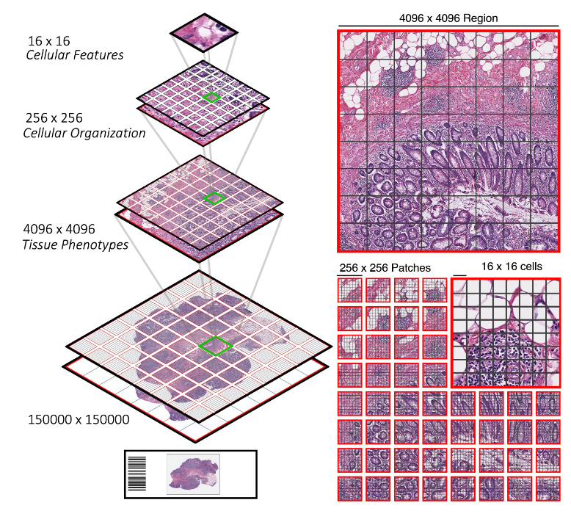
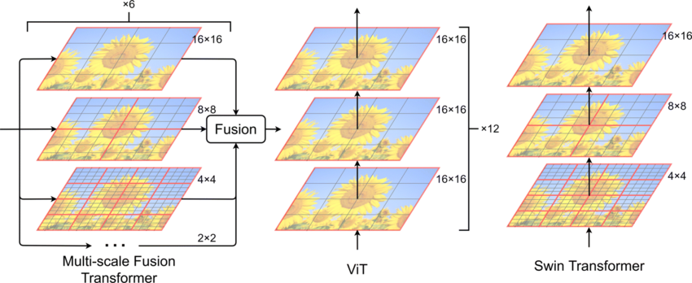
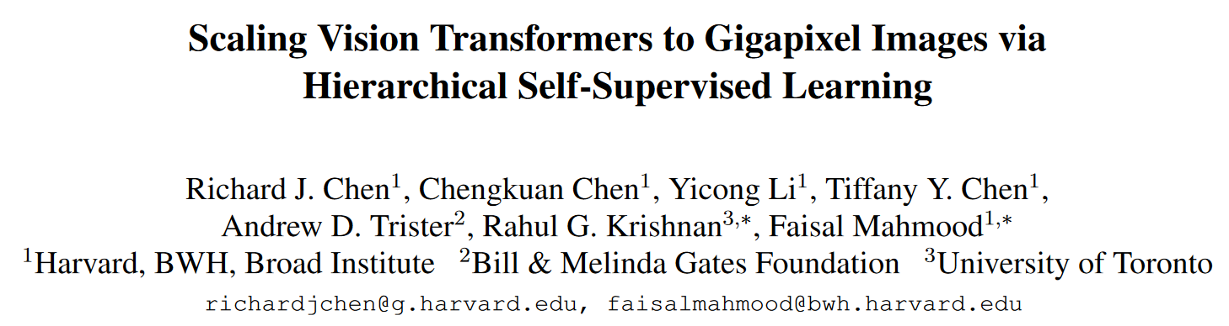
Methodology Overview
Pathomic
Radiomic
Independent prediction from interpretable hand-crafted features (radiopathomic)
  Radiomic: e.g. pixel texture, shape of tumor etc
  Pathomic: spatial architecture of TIL cells, collagen fiber orientation etc
Deep learning-based integration (CNN, Transformer etc)
→ 2000x2000 region-level representation
Vision Transformer vs Swin transformer
Multi-scale feature within pathology slides

Slide 4
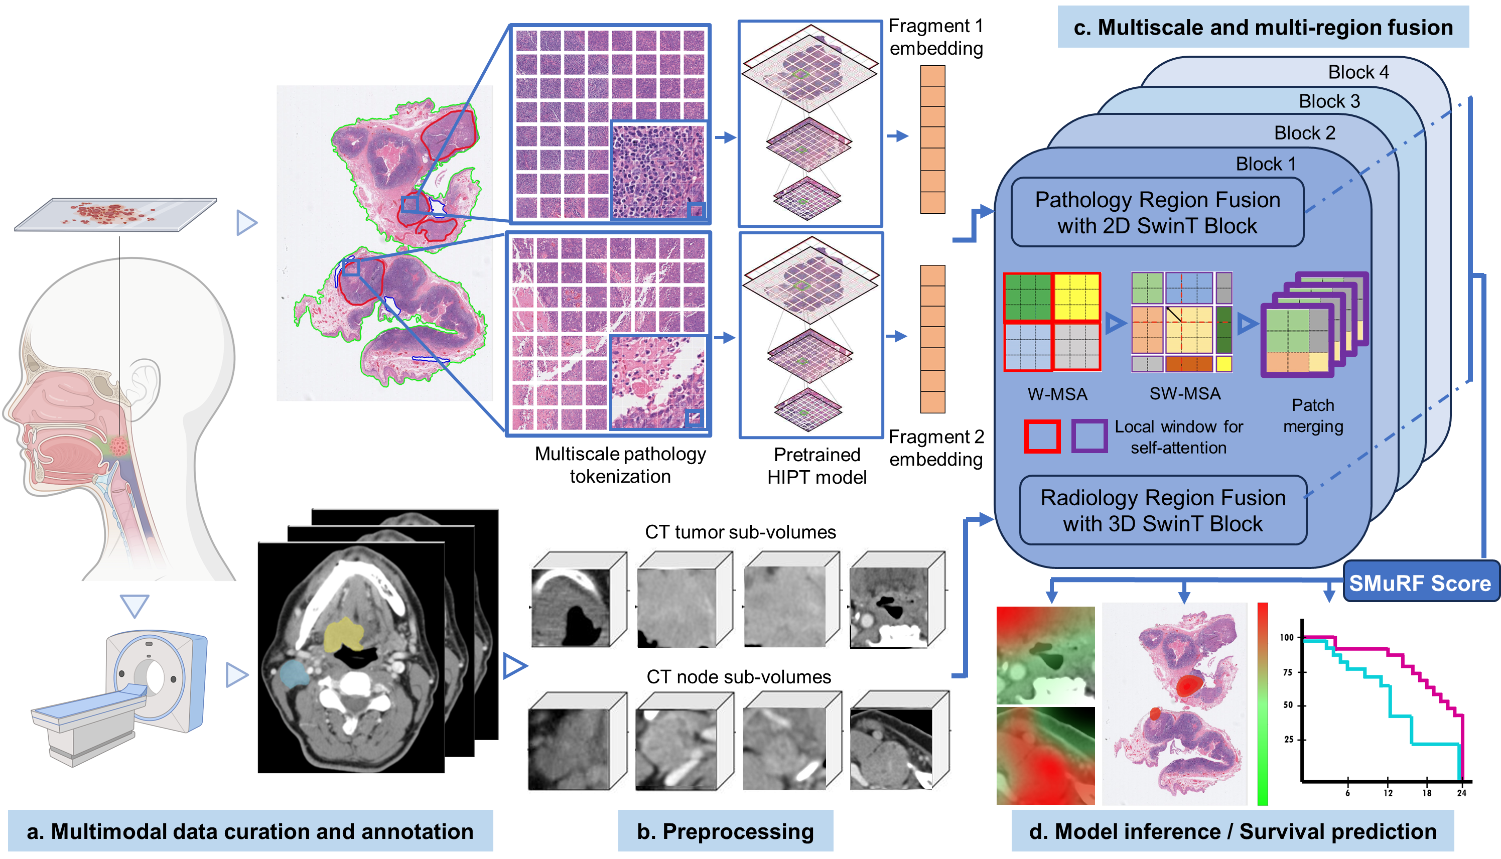
Workflow
SMuRF:Swin Transformer-based MultiModal and Multi-Region Data Fusion Framework

Slide 5
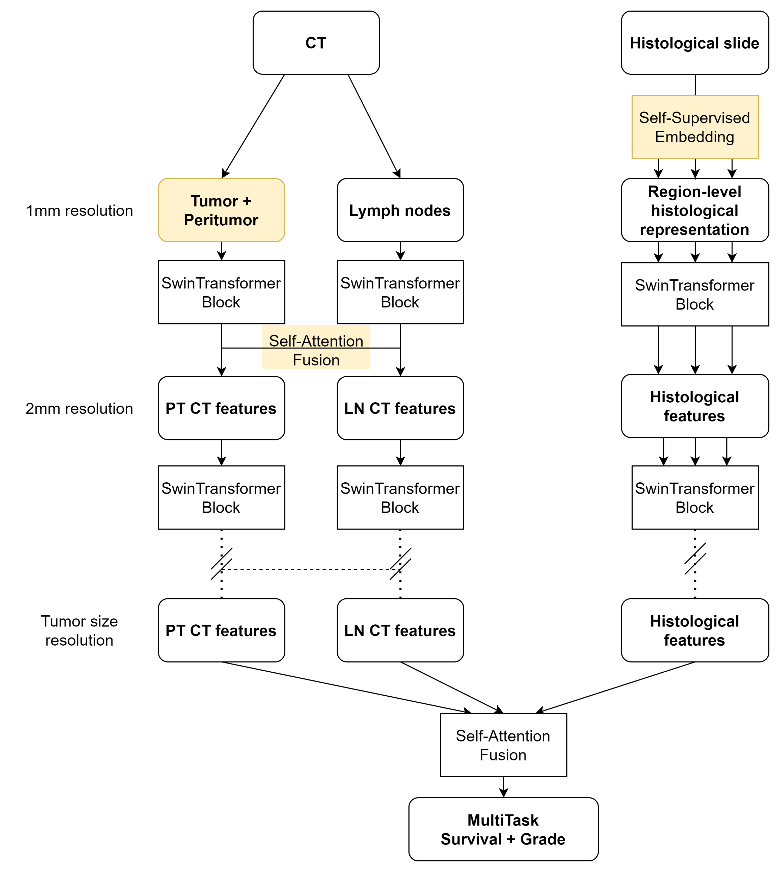
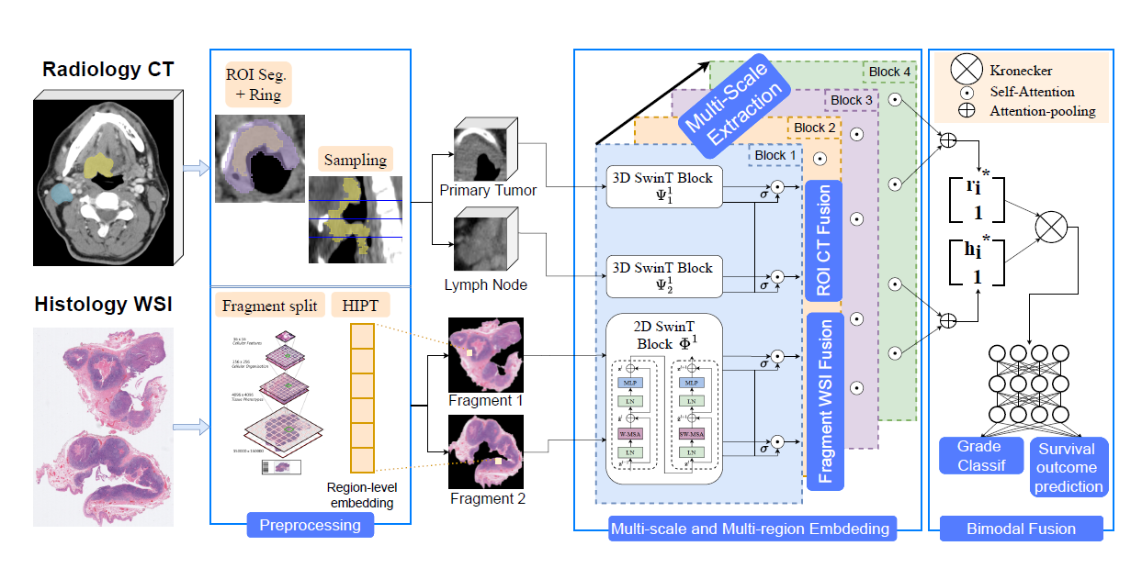
Workflow details
Enable information interaction between different regions within radiology (tumor and lymph node) and pathology (tissue fragments)
Model structure is versatile: handle different data type and outcomes
Seamless integration of multiscale data type

Slide 6
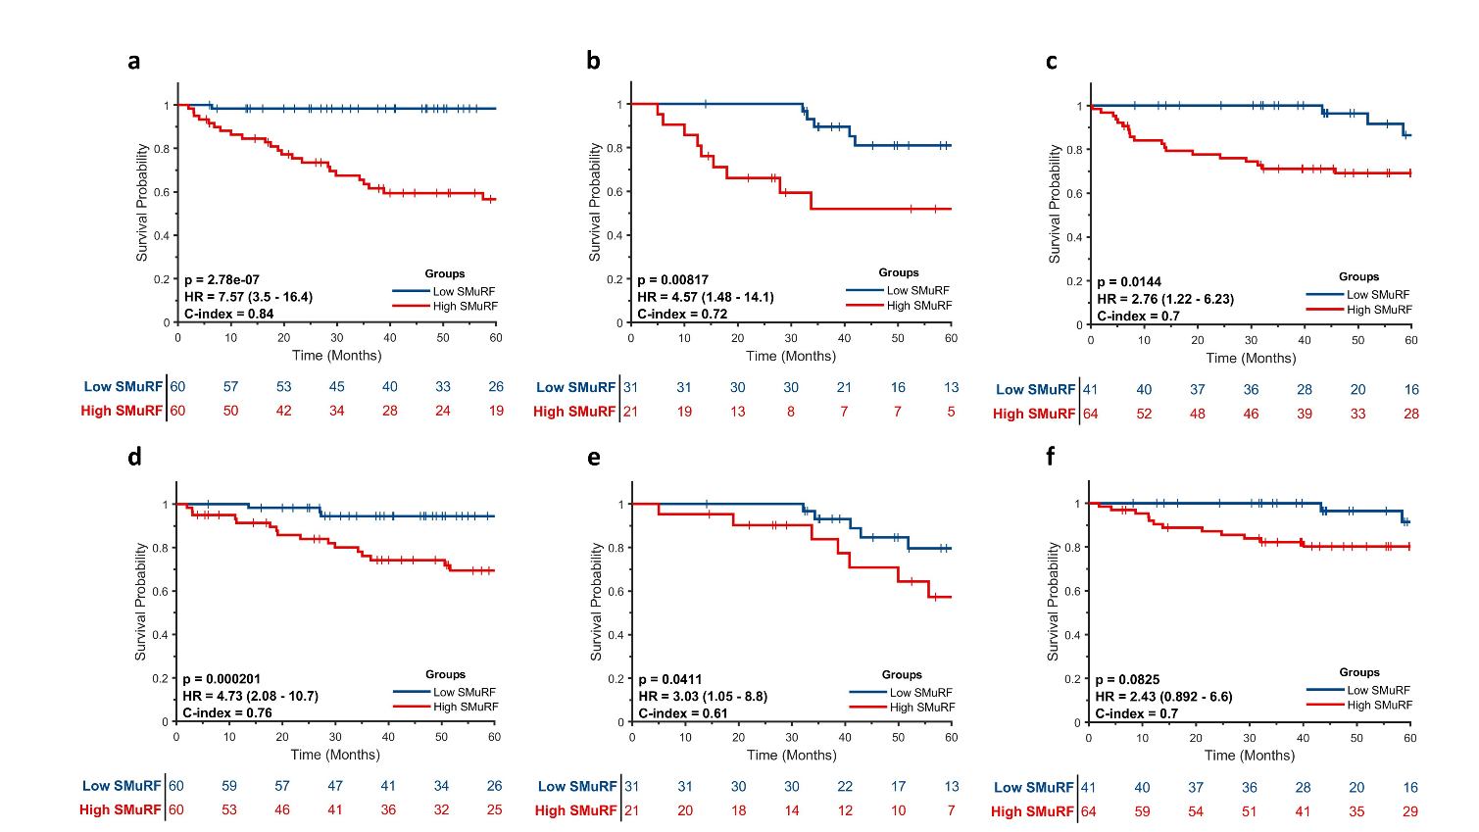
Quantitative Results
The Kaplan-Meier survival analysis of SMuRF for disease-free survival from training (a), validation (b) and external test (c) and for overall survival from training (d), validation (e) and external test (f).

Slide 7
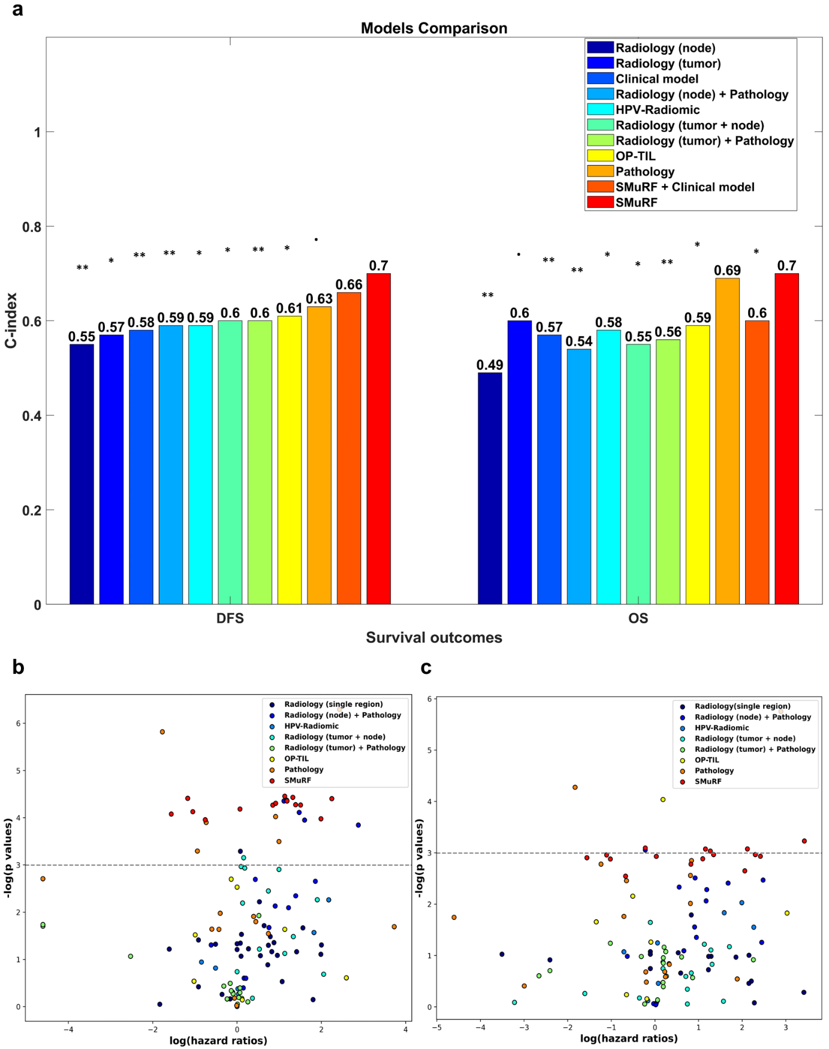
Quantitative Results
Model comparisons: C-indices on 11 comparable models (a) accounting for input imaging modalities, cancer habitat regions considered and feature extraction methods (i.e. radiomic, pathomic or deep learning).

Slide 8
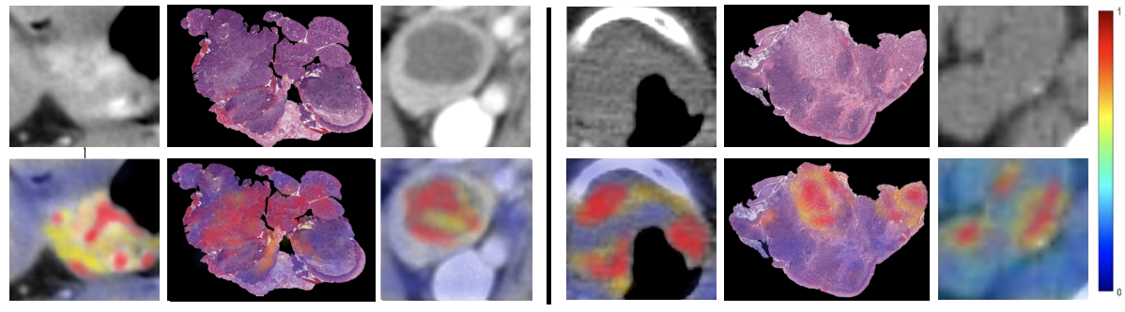
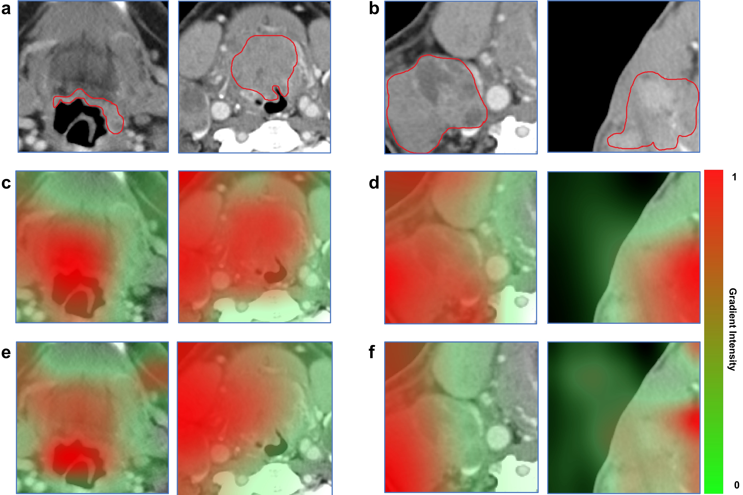
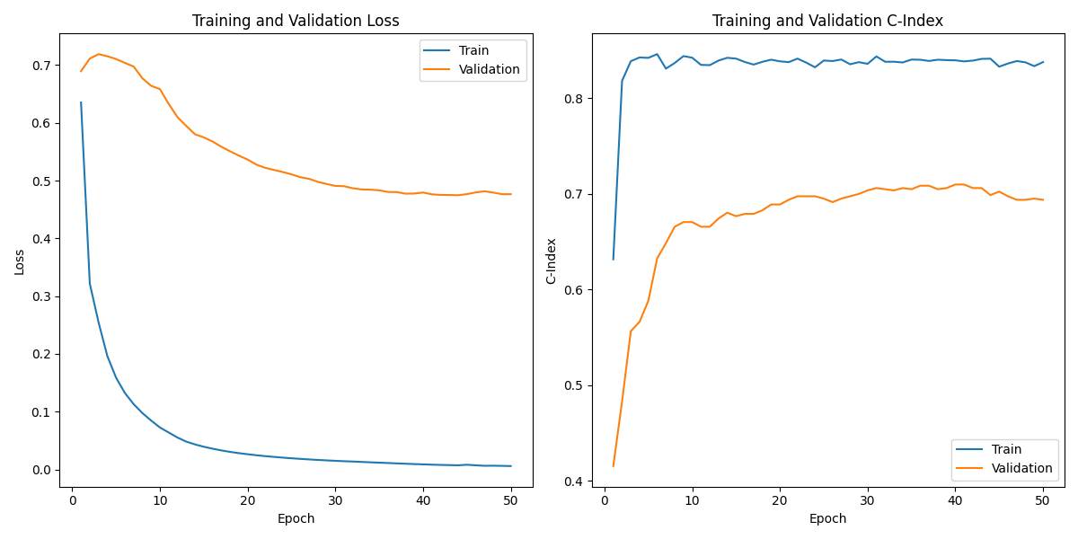
Qualitative Results
GradCAM result:
Good prognosis Bad prognosis
Where is the model focusing at to make the predictions?
  Integrative Gradients (IG)
  Gradient activation map (GradCAM)
IG result:
CT Tumor Pathology tumor CT lymph node CT Tumor Pathology tumor CT lymph node
CT Tumor CT lymph node CT Tumor CT lymph node
CT images
SMuRF’s attention
Unimodal attention

Slide 9
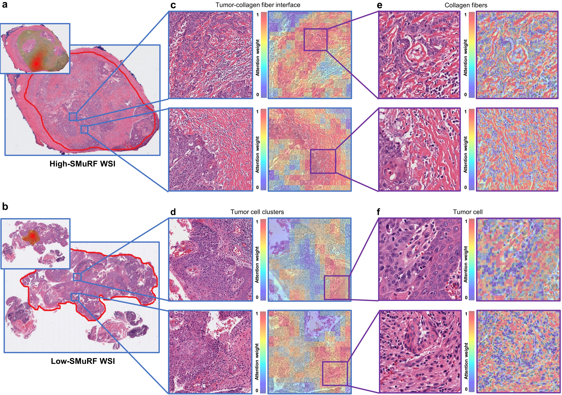
Qualitative Results
GradCAM overlaid to highlight prognostic relevant regions (top left) detected by SMuRF. For each pathology WSI, two example 2048×2048 patches with corresponding attention heatmap (c, d) within the highlighted prognostic relevant regions are provided. The attention heatmaps at a patch size of 128 (macro-scale) expressed differently : there are more condensed high attention areas resulted by the tumor-collagen fiber interface for the high-SMuRF WSI than the low-SMuRF WSI, which contains primarily the tumor cell clusters. The attention heatmaps at a patch size of 16 (micro-scale) highlighted individual collagen fiber (e) for high-SMuRF while emphasized mainly the tumor cells (f) for low-SMuRF WSI. These interpretation of attention heatmaps are confirmed by pathologist.

